Slide 1
PYTHON PROGRAMMING
LAUNCHCODE
August 23, 2025
Asfand Khan

Slide 2
Questions + Homework Review
https://github.com/Asfandyar-Khan/LaunchCode/
Contains lectures
Powerpoint files
Google Colab
Contains homeworks
To be completed prior to class
Any unfinished or challenging questions are taken up at the start of class
Please notice a new file – “Python Project Ideas”
Any questions about last week’s homework?

Slide 3
Review of Past Class
Week 6 Homework Review
For Loops review
For Loops only work with:
Strings, range() function, lists, or tuples
Do not work with: integers, must use range() instead to work w/ numbers
New data type: Lists
Using strings – list of fruits: list = [“apples”,“bananas”]
Using integers – list of numbers: list = [0,1,2,3]
List methods:
.append() - adds items to an existing list
Index[] - allows for accessing of elements inside a list

Slide 4
Today We Will Cover...
Week 7 Homework Review
Python Project Ideas
Knowledge Check – For Loops Using .append() Method
Review of Lists
Including methods
Knowledge Check – Lists: Using Loops and adding numbers
Lists – Using them in Functions and For Loops
Tuples
How are they different from lists?
Conditionals
Boolean expressions
If/Else statements
Chained conditionals

Slide 5
Knowledge Check – Lists: Using .append()
Question: Adding an Item to a List
You have a list of favorite games called game_list:
python_game_list = ["Minecraft", "Roblox"]
Use the .append() method to add the game "Fortnite" to the end of the list.
After you append it, print the list to see the result.
Hint: To use append, you write the list name, followed by .append(), and put the new item inside the parentheses.

Slide 6
Python Data Type - Lists
Lists
Lists are a data structure that is used to collect data items
They are mutable (changeable)
Lists maintain a defined order
The first item is given priority
Then the second item, and so on…
Items can be retrieved using index numbers (starting 0)
Items are stored in square brackets [ ]

Slide 7
Knowledge Check - Lists
Question 1: Printing a List with a Loop
Create a function called print_animals() that has a list of 3 animals inside it (for example: "dog", "cat", "rabbit"). Use a for loop to print each animal from the list.
Hint: Define the list inside the function, then use for animal in list: and print each one.
Question 2: Adding Up Numbers in a List (Return Value)
Create a function called add_list(numbers) that adds up all the numbers in a list and returns the total. Store the total in a variable called total.
When you call the function, store the result in a variable called answer and then print answer.
Hint: Start with total = 0 and use a for loop to add each number.

Slide 8
Python Data Type - Tuples
Tuples
Similar to lists, tuples are a sequence of values
They are non-mutable (unchangeable)
Tuples can store different types of data (numbers, strings, etc.)
You can access items in a tuple using index numbers (starting at 0)
Tuples are useful if you want a fixed set of values that should not be modified
Items are stored in circle brackets ( )

Slide 9
Lists and Tuples – What’s the difference?
Mutability (The Big Difference!)
List: You can change them after they are created (using .add(), .remove() methods)
Tuple: You cannot change them after they are created
Syntax:
Lists use square brackets while tuples use circle brackets
Easier and faster to pull data from a tuple due to using less memory (because of their fixed size)
List has many methods while tuple has very few methods

Slide 10
Conditionals
Conditionals let your program make decisions and choose different paths!
If: The starting point – “if this condition is true, then do this”
elif: Short for “else if”. Checks another condition only if the previous one was false
else: “If none of the above conditions is true, then do this instead”

Slide 11
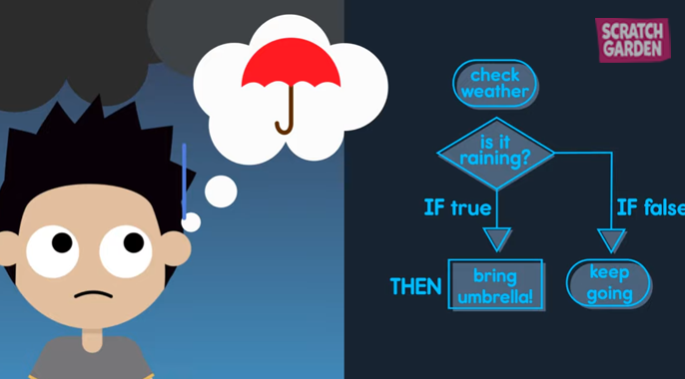
Conditionals – If/Else Statements

Slide 12
Conditionals – Comparison Operators
Conditions are built using comparison operators:
== (equal to)
!= (not equal to)
> (greater than)
< (less than)
>= (greater than or equal to)
<= (less than or equal to)

Slide 13
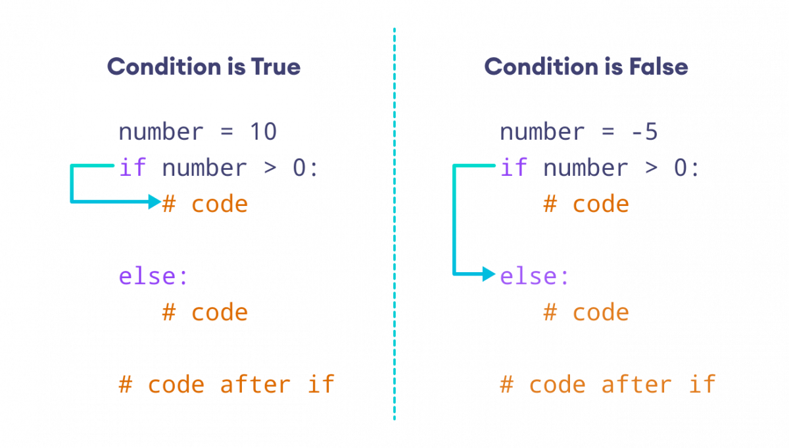
Conditionals – If/Else Syntax

Slide 14
Conditionals – If/Else Example
weather = "raining"
if weather == "sunny":
print("Wear sunglasses! 😎")
elif weather == "raining":
print("Don't forget your umbrella!☔")
else:
print("Have a great day! 🙂")
# This would print: "Don't forget your umbrella! ☔"

Slide 15
Review and Questions
Homework will be posted tomorrow!
Asfand Khan

